Slide 1
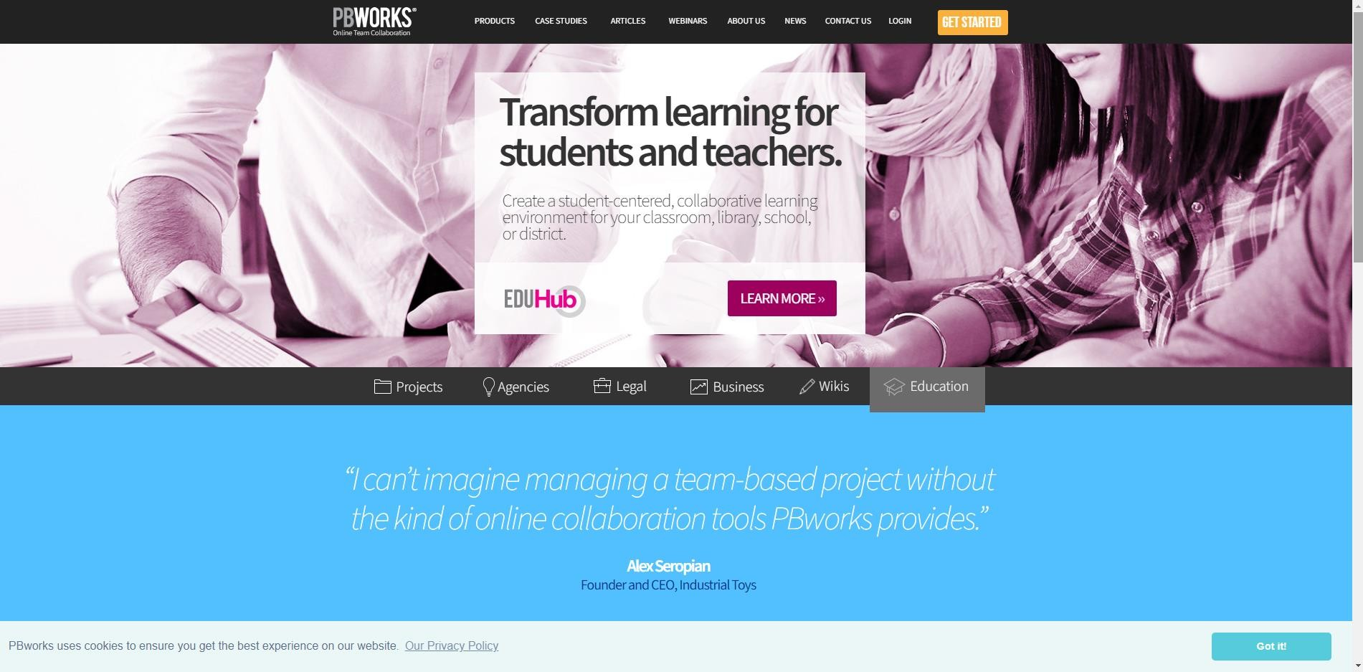


Slide 2


GPS for Today’s Session:
Sign up for the workplace
Working with your Wiki
  Front Page
  Settings
  Creating Student Account
  Pages & Files
  Editing a Page in a Wiki
  Viewing recent activity
  Using the Sidebar
  Uploading files ( images and files)
Application in the classroom

Slide 3


Slide 4
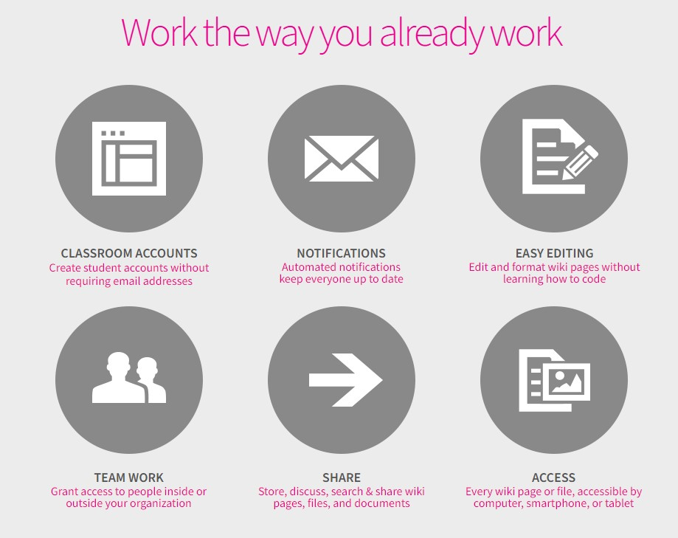

Slide 5
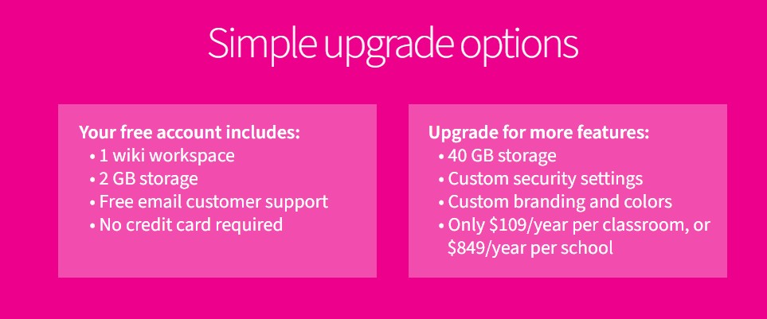

Slide 6
Step One
Sign up for the workplace
You will need to be on the Internet to access www.pbworks.com
(the host for your wiki).
Note: You do not have to be at school, any computer with Internet access will work.
Go to www.pbworks.com

Slide 7
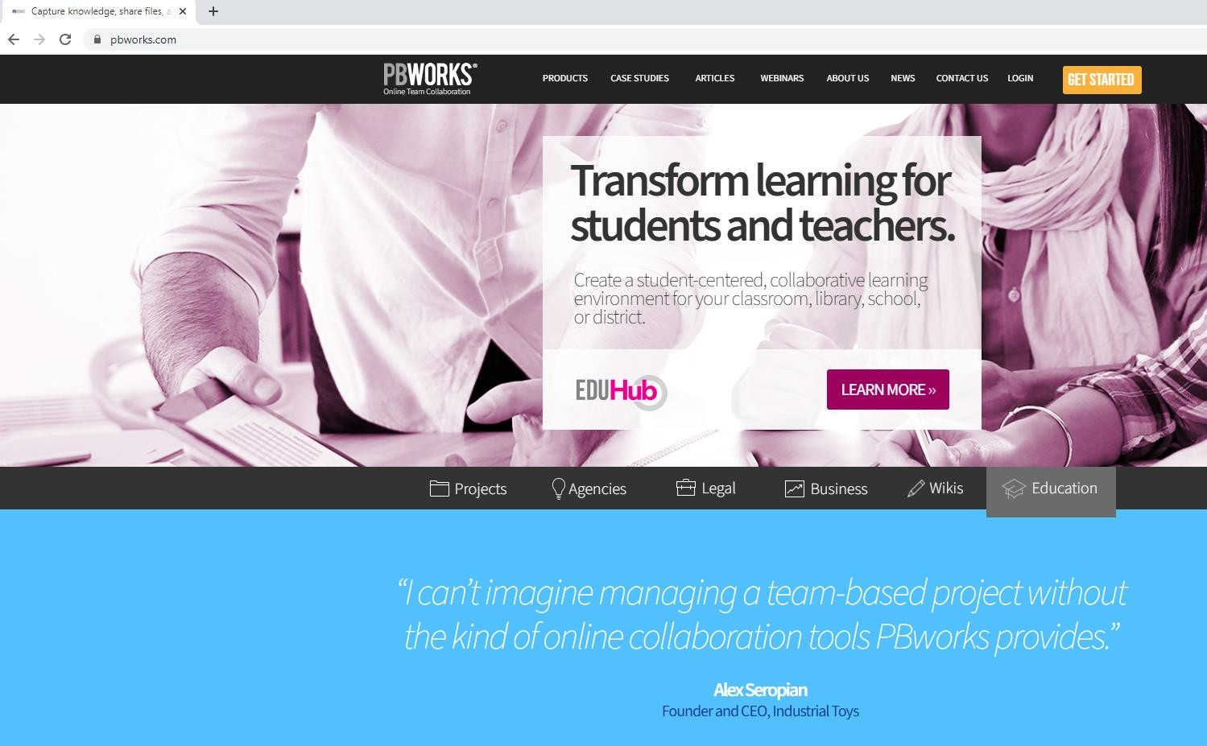
www.pbworks.com
Click “Sign Login”
button/ “Get
started” button

Slide 8
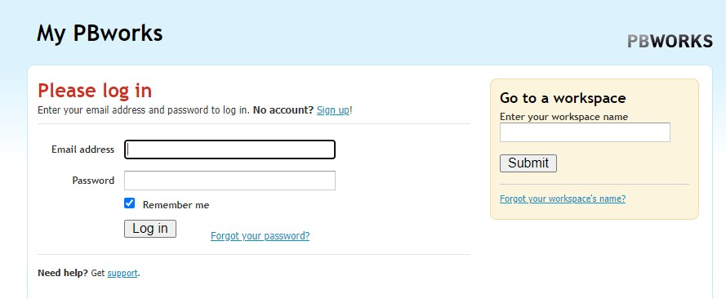
Login Button
Click “Sign Up” to
create your wiki

Slide 9
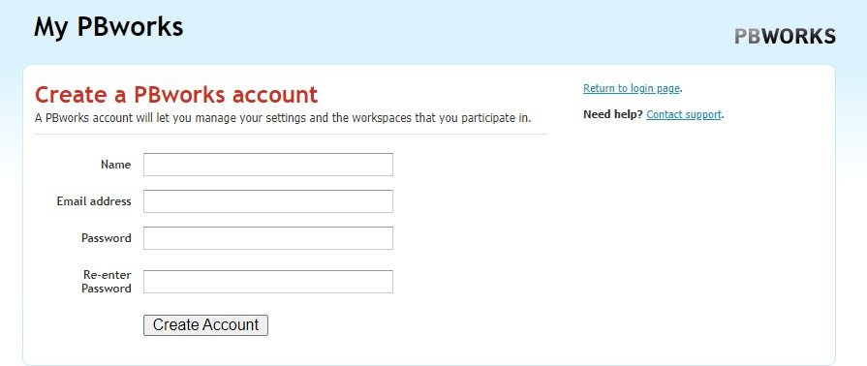
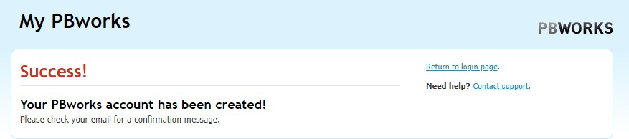

Slide 10
You will be asked to sign in with some basic information.
You may want to use a non-school email account (you can set the wiki to send you emails when the wiki is updated)
Choose an address that is easy for you and your students to remember. For example: classxiienglish.pbworks.com

Slide 11
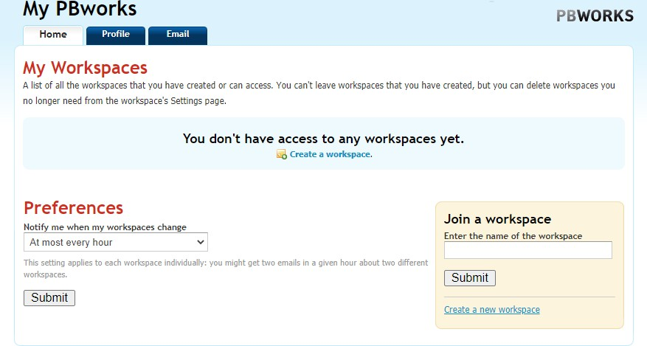

Slide 12
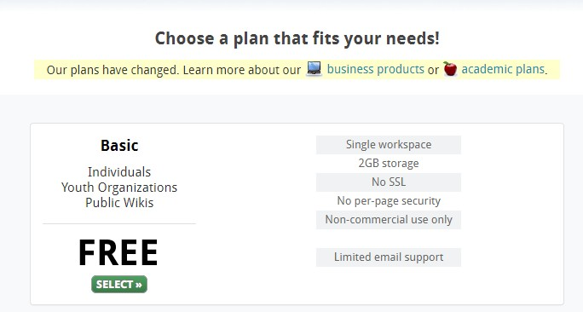

Slide 13
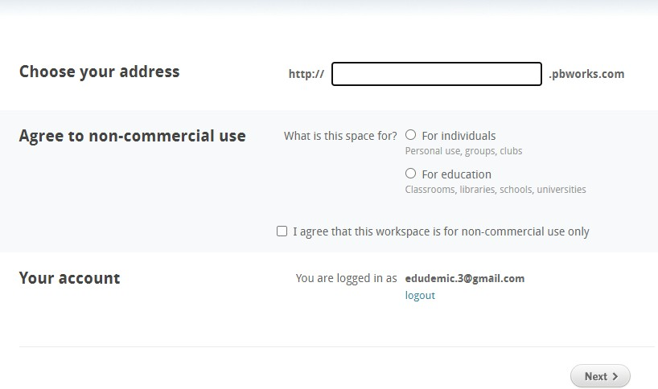

Slide 14
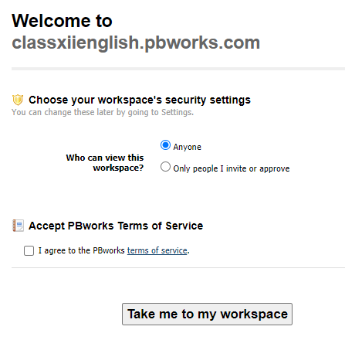
Settings
Here you will choose who will have access to edit and view your wiki. You can change these settings later, but you may want to keep your wiki private until you are ready to share it with your students.

Slide 15
You are now the proud owner of a collaborative wiki!

Slide 16
Step-2
Working with your Wiki
Working with your Wiki You should see your FrontPage, which is the same as a home page for a website.
To edit this page (or any other page in your wiki), click on the edit tab.
PB works provides some examples to view, you can delete anything you don’t want (except the FrontPage and the Sidebar)

Slide 17
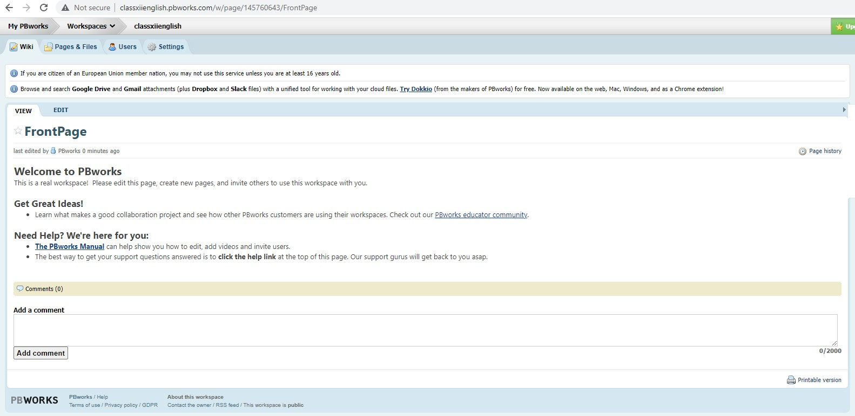

a)Front Page
To edit this page (or any other page in your wiki), click on the edit tab.

Slide 18
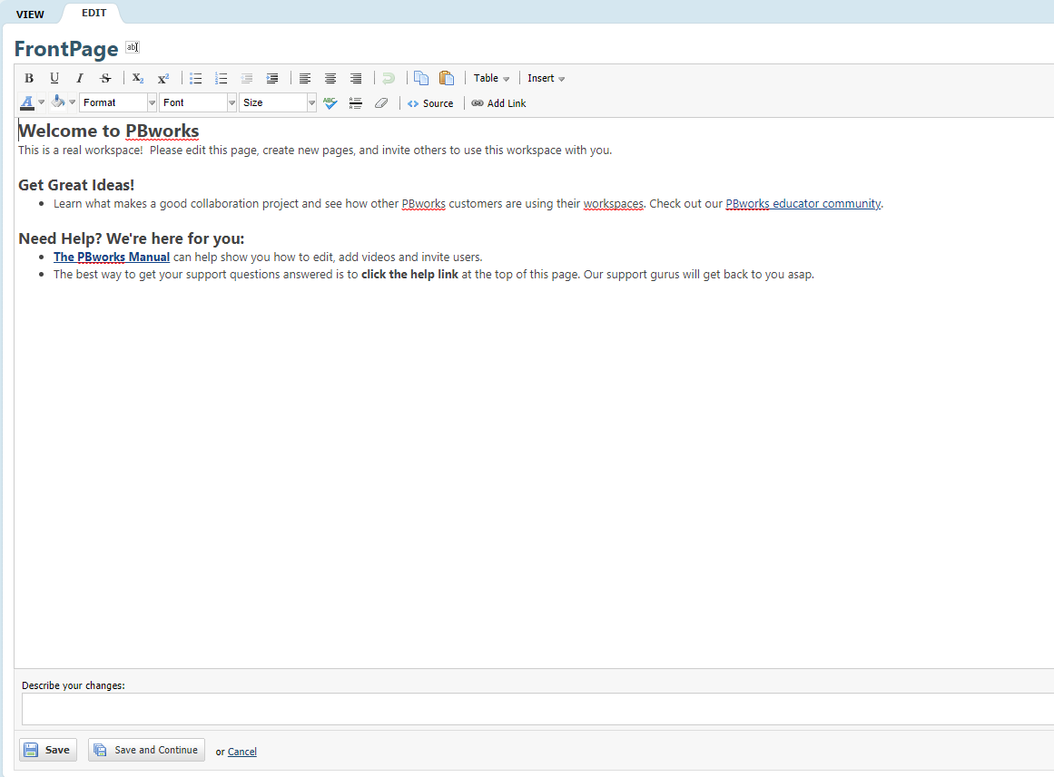

Your FrontPage is the homepage for your wiki To edit the pages in your wiki
PB works provides some examples to view, you can delete anything you don’t want (except the FrontPage and the Sidebar)

Slide 19
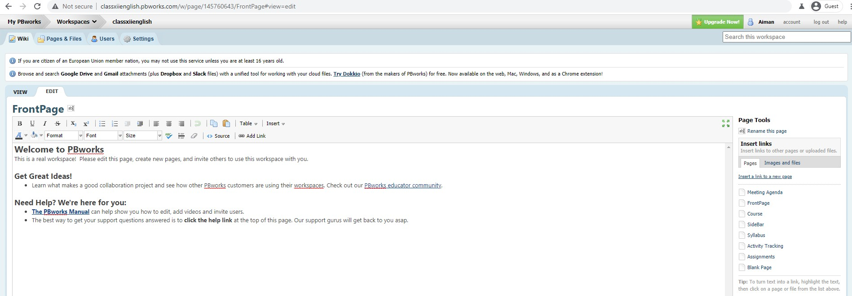

You should see your name

Slide 20
b. Settings
Settings Click on “Settings” to access your
options for your workspace
Your settings options include:
About this Workspace
Security and Access
Creating accounts for your students (you will need a printer to complete this step)
Setting your email preferences

Slide 21

Click on “Settings” to manage your wiki (create student accounts, set security and access settings, select background colors)

Slide 22
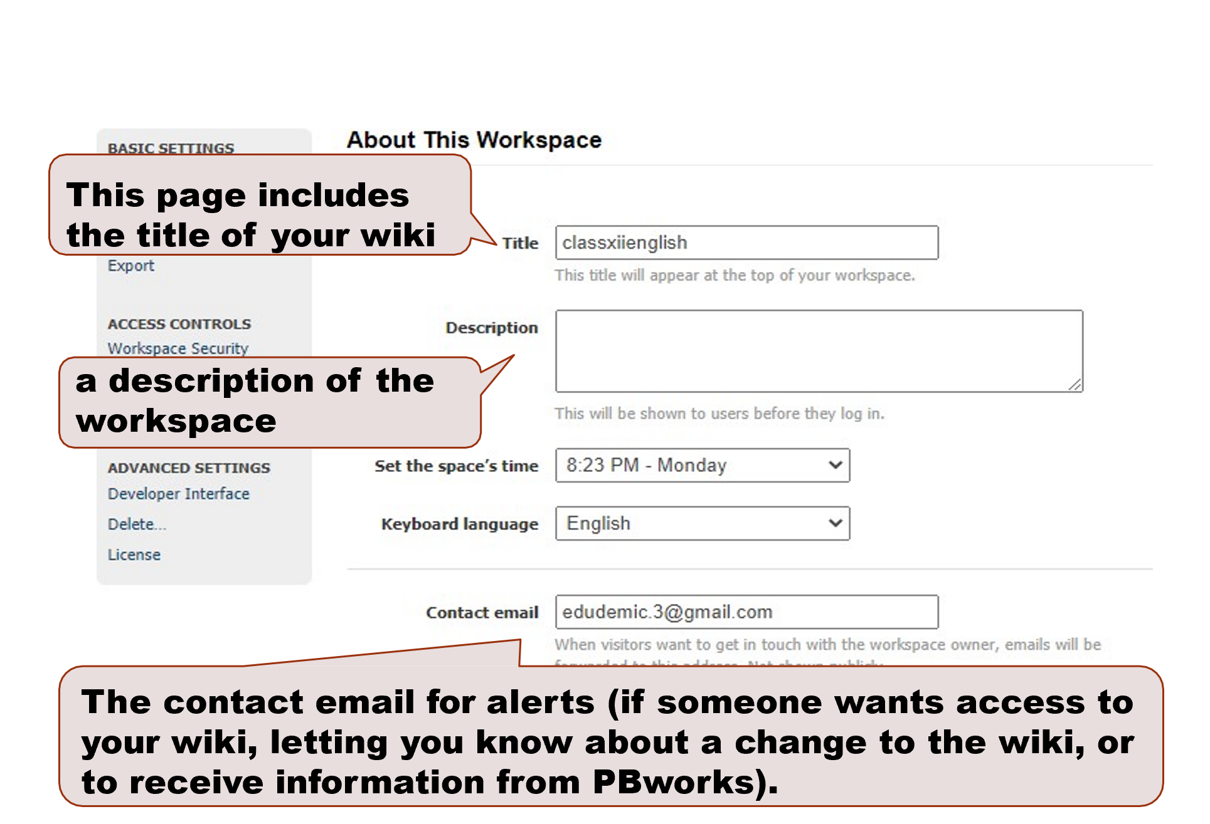

Slide 23
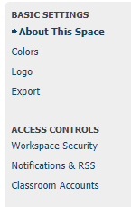
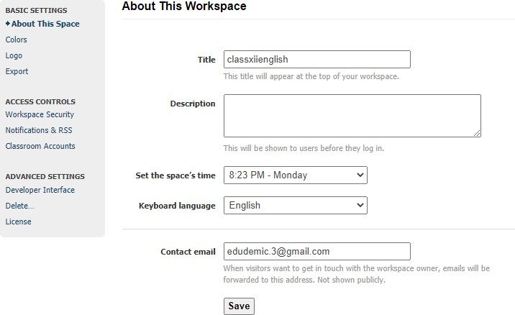

Slide 24
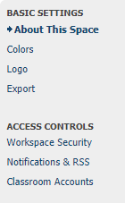
This page will let you change the settings access to your wiki (viewing and editing) You will be able to set up individual accounts for your students in the Users section.
This is an important step for keeping your wiki safe for your students. Choose “Only people I invite or approve”

Slide 25
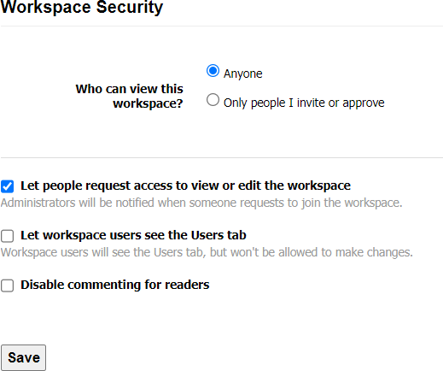

Slide 26
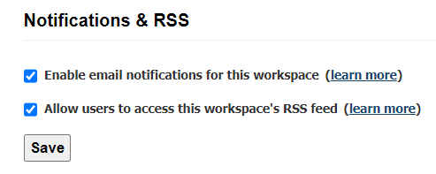
You can set your notifications options (receiving emails when the workspace is changed)

Slide 27
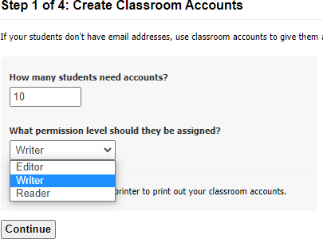
c) Creating Student Account

Slide 28
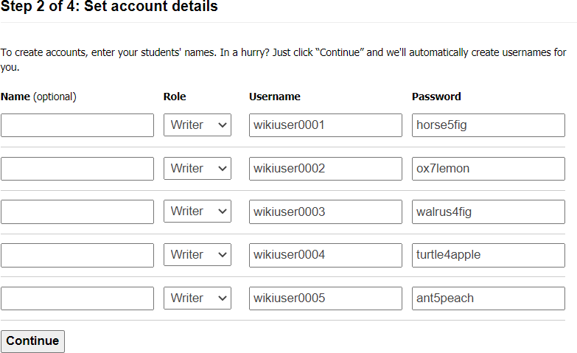
You will be able to give your students usernames for their wiki accounts. For privacy and safety, it is recommended that you use initials or first names only.

Slide 29
Check the list carefully, you can add more students later, but you will not be able to change these accounts once confirmed.
The next screen will prompt you to print your account information

Slide 30
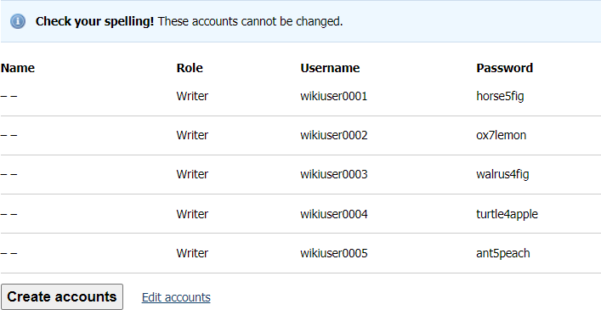
Step 3 of 4
You will be asked to confirm your students’ usernames and passwords. After confirming, a PDF of the account information will be generated for you to print, cut, and distribute to your students.
Check the list carefully, you can add more students later, but you will not be able to change these accounts once confirmed. The next screen will prompt you to print your account information

Slide 31
Student Accounts:
Step 4 of 4 This page will ask you to print your account list. The list will be divided into strips for you to cut and distribute to your students.
You may want to copy a master list for your records.
You will cut apart and give to your students. You may want to make a master copy for your records.

Slide 32
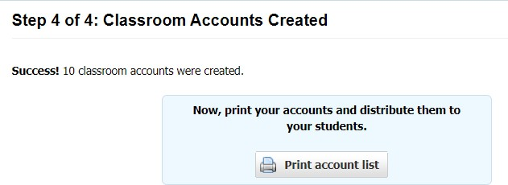

Slide 33
Student Accounts:
Print out Your print out will include a master list at the top and a divided list (for individual students) at the bottom. You may want to make a copy before giving to your students.
After printing, make a master copy before you cut and give to students

Slide 34
These are sample pages. You can click the box beside Name to select all
(but you will have to deselect FrontPage and SideBar before clicking Delete)
Deselect FrontPage and SideBar before deleting the sample pages

Slide 35
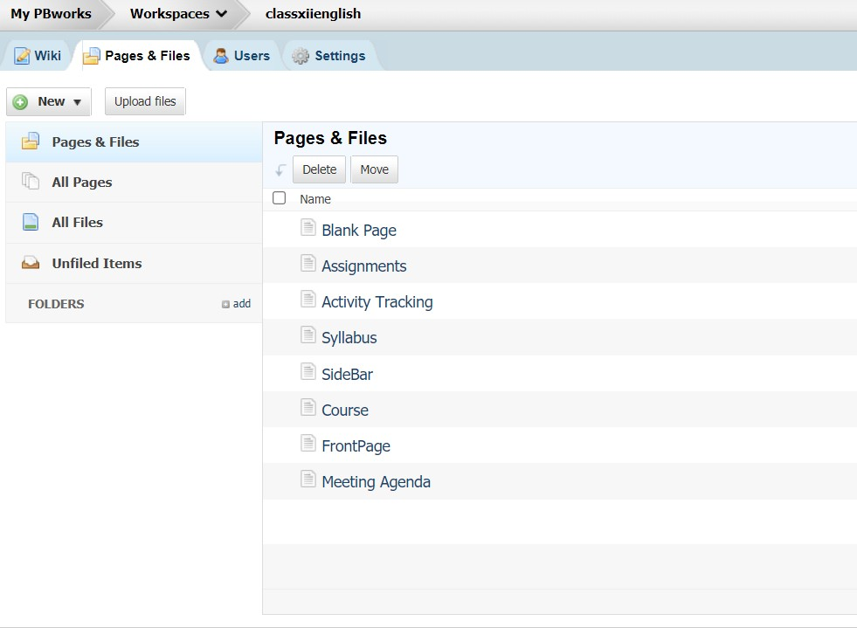
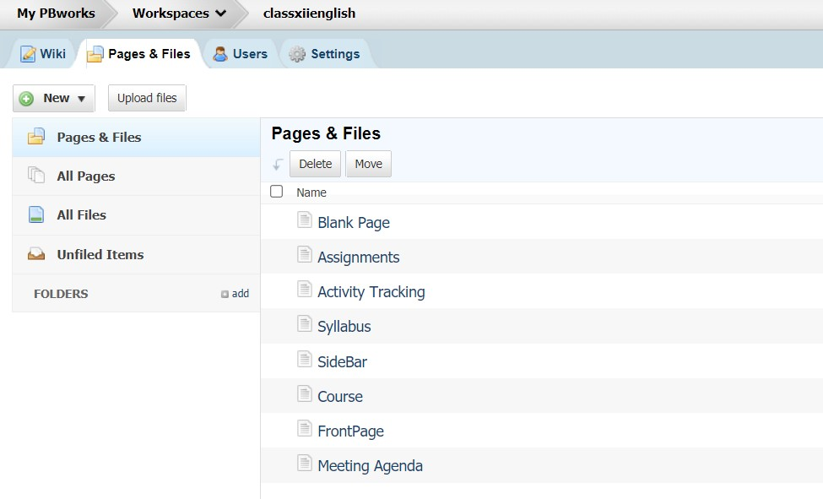

d) Pages & Files
PB works provides example pages. You can select and delete everything except the FrontPage and the SideBar
Click ‘add’ in front of ‘Folder’ to create a new folder

Slide 36
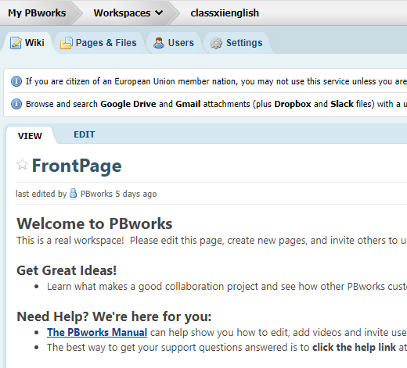
e. Editing a Wiki
Editing a Wiki
You may want to create your text in Word first, and then copy and paste onto the wiki page.
(I recommend this to my students as the editing options are more familiar in Word).
Click on “Edit” to work on any page in the wiki. You may want to copy and paste from a Word document.

Slide 37
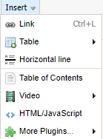
Bold Underline Italics
Superscript Subscript
Bullets Indent
Alignmen t
Copy Paste
Table Insert
Undo
Font Colour Backgroun d colour
Style Font Size
Grammar Check Insert Horizontal Rule
Remove Formatting
Add Source & link

Slide 38
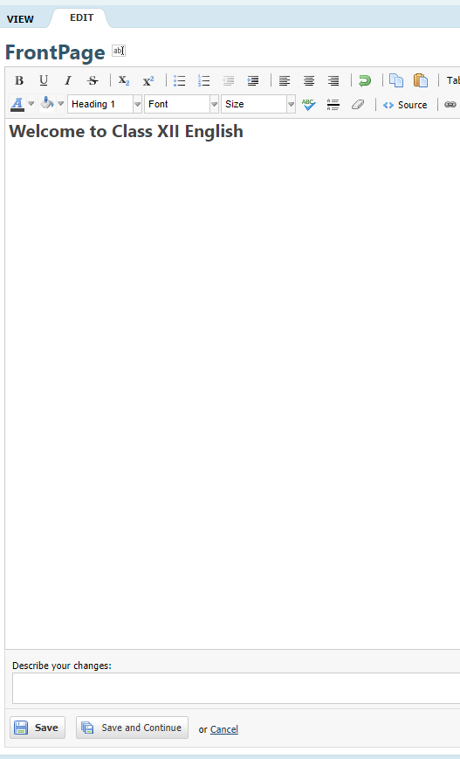

Saving Changes
When you’ve finished working on the page, click Save

Slide 39
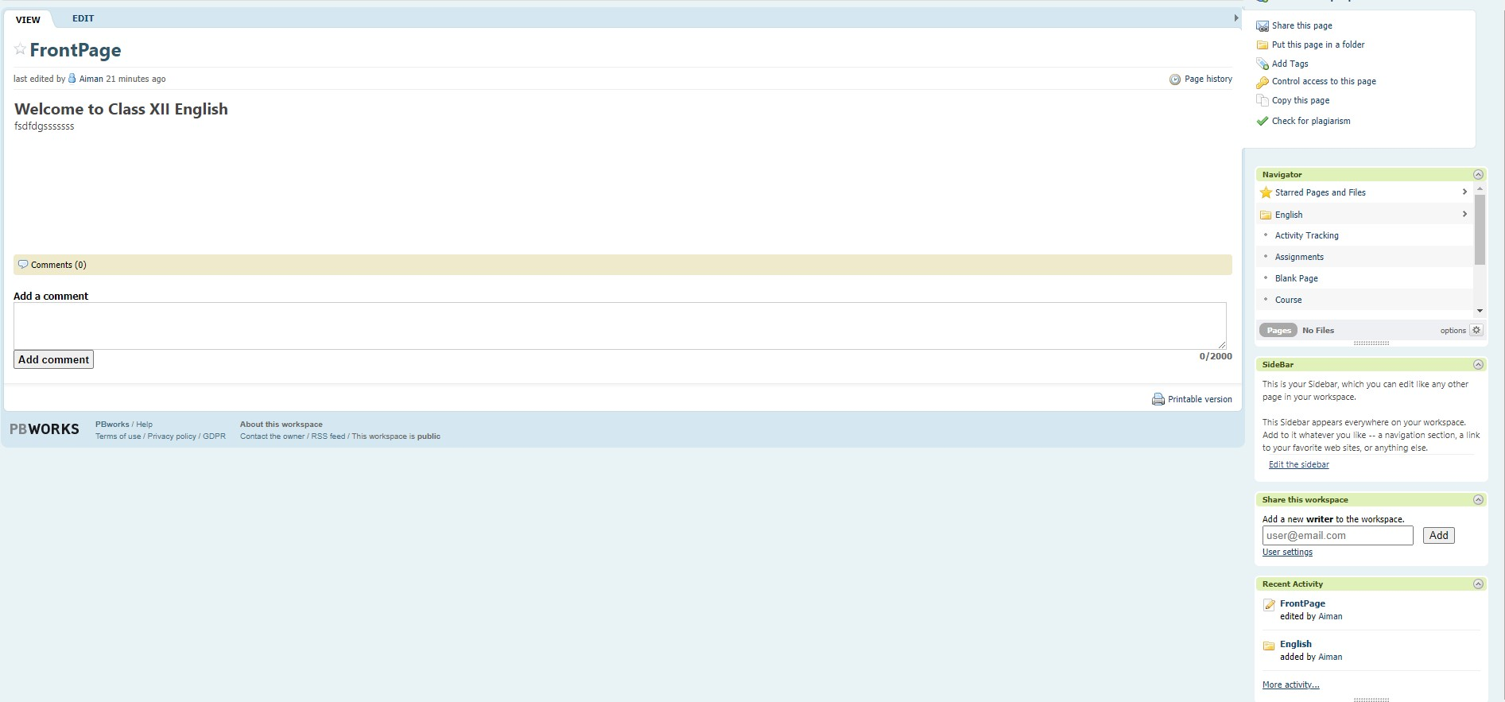
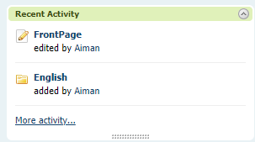
f) Viewing recent activity
Reviewing Recent Activity Use the recent activity option to
track your students’ work and interaction with the wiki You can sort and view by pages, comments, and edits and see who made the change to the workspace. The recent activity bar is located on the bottom right of the screen (this shows the most recent changes). To see older changes, click “More Activity”.

Slide 40
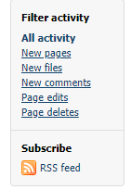
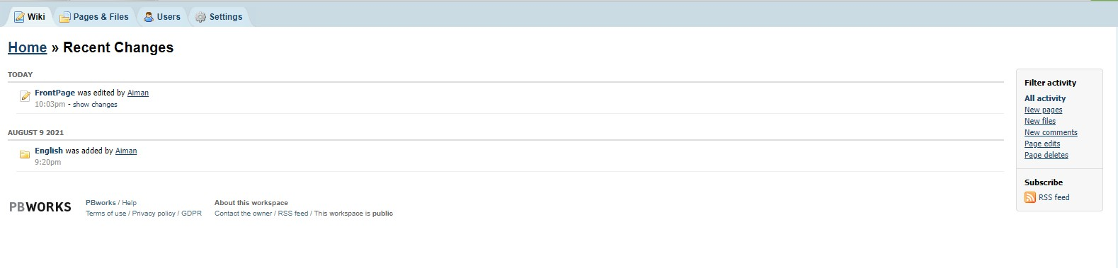
You can view changes by pages, files, comments, page edits, and page deletes

Slide 41

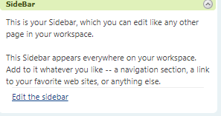
g) Using the Sidebar
The SideBar can be used to provide links to frequently used websites, wiki pages, or resources. You may also want to use it as a navigation bar for the workspace.

Slide 42
The Sidebar can be used for navigation or to show frequently used websites or other resources. To edit the Sidebar, click the link

Slide 43
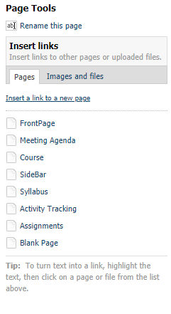
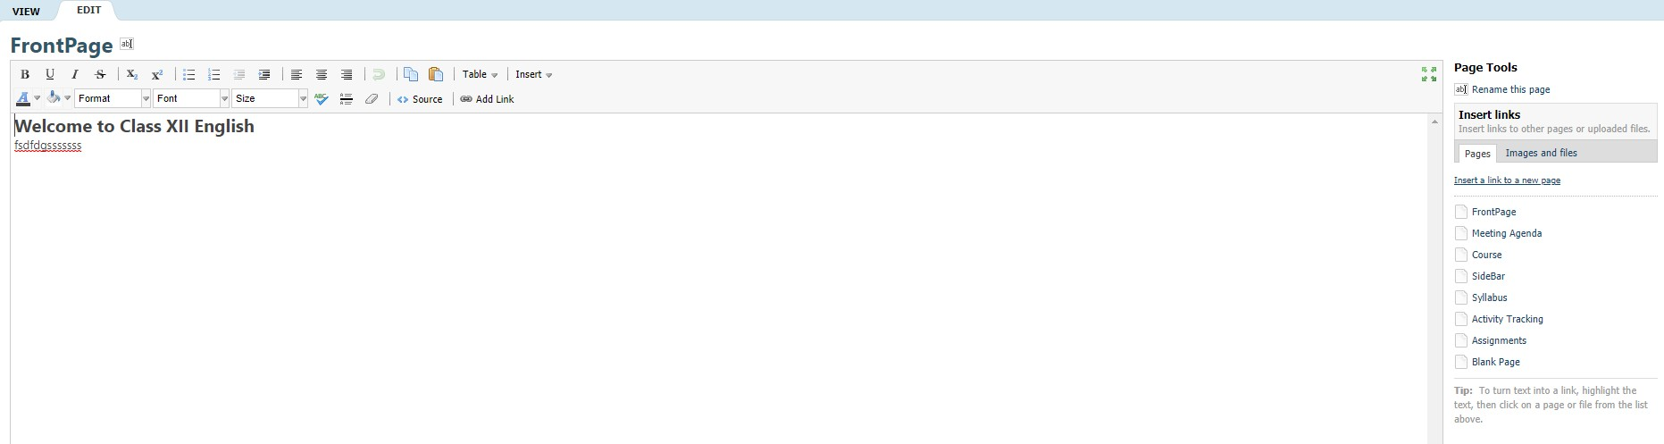
h) Uploading files ( images and files)
Click here to Rename the Page
Click here to insert a link or upload an image or file

Slide 44
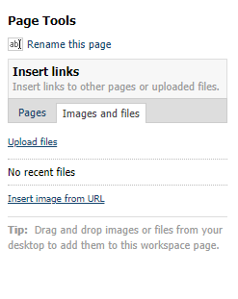
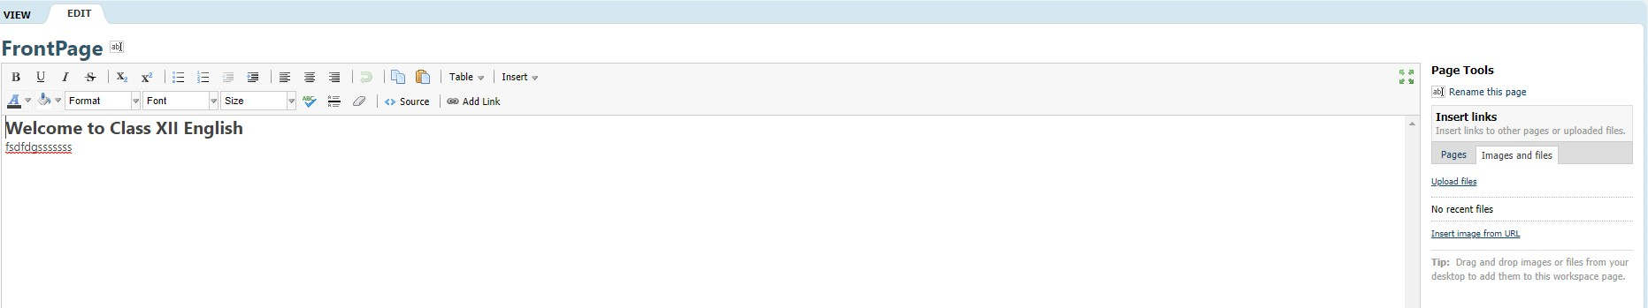
Uploading Files You can upload images and files to your wiki. When in “Edit”, you will see an option on the right side of the screen to Insert links to files. Click on the type of file you want to upload or link (pages or images and files).
Follow the prompts to complete the upload.

Slide 45
Application In The Classroom
Information Courtesy: https://sites.google.com/site/inteched/wiki
Suggestions for using Wikis in your classroom:
Have students to use their wiki folder to store and organize their notes. You can monitor their progress, and their peers can offer constructive support.
Use the wiki to display student work (either link to document or import multimedia)

Slide 46
3. Evaluation of the writing process (you can monitor their editing and revision)
4. Provide information for research projects, study guides, journals, and other assignments.
5. Use the wiki as your website - you can update it as often as you need to, and you can attach documents to specific student folders if someone is absent or needs additional work or support.
Information Courtesy: https://sites.google.com/site/inteched/wiki

Slide 47
You and your students can communicate quickly on an assignment, making the most of your instructional time.
Collaborative assignments: Each student can complete their part, and you will have documentation of what each group member contributed (individual logins and passwords).
8. Assessments, Journals, research, independent projects
Information Courtesy: https://sites.google.com/site/inteched/wiki

Slide 48
9. Use the wiki to create an electronic portfolio for your students
10. A wiki can be a great alternative to writing journals. The wiki encourages students to give feedback to each other, but it also allows students to "see" the writing process as their peers continuously revise and edit their writing.
Information Courtesy: https://sites.google.com/site/inteched/wiki

Slide 49


Thank You

